Slide 1







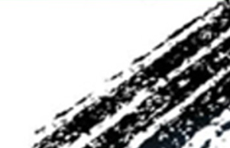

Chongqing University of Technology
ATAI
Advanced Technique of Artificial Intelligence
Chongqing University of Technology
Spectrum-based Modality Representation Fusion Graph Convolutional Network for Multimodal Recommendation
Code：None
—— SIGIR 2025
2024.12.26 • ChongQing
Reported by Peng Shan

Slide 2
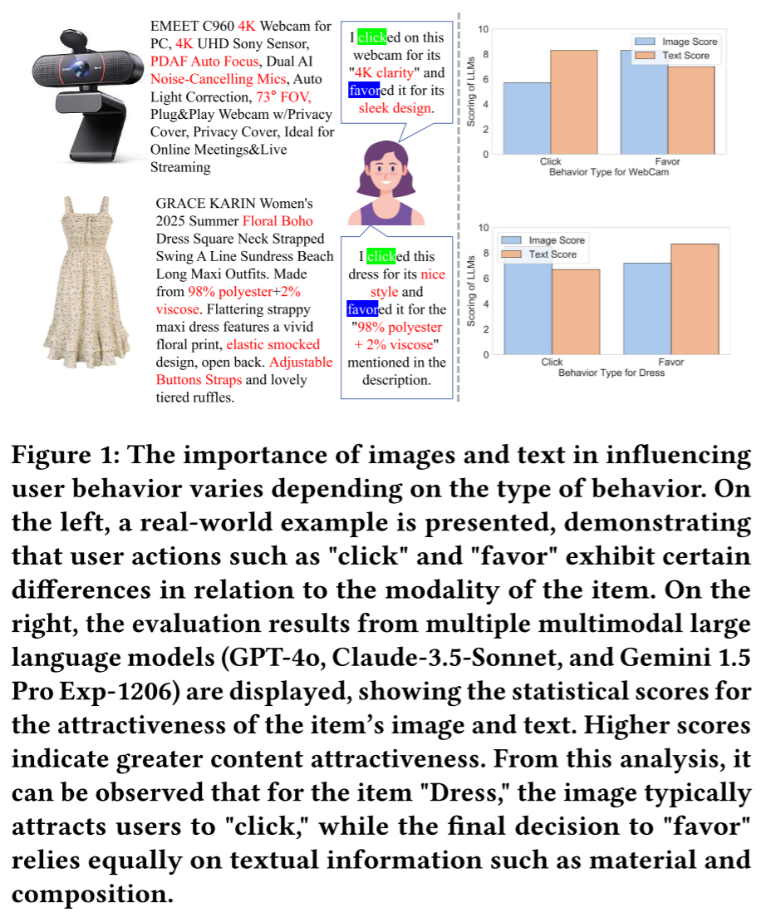
Motivation
Existing methods still face the following critical issues:
the lack of effective characterization of modal preferences across different behaviors, as user attention to different item modalities varies depending on the behavior;
the difficulty of effectively mitigating implicit noise in user behavior, such as unintended actions like accidental clicks;
the inability to handle modality noise in multi-modal representations, which further impacts the accurate modeling of user preferences.

Slide 3
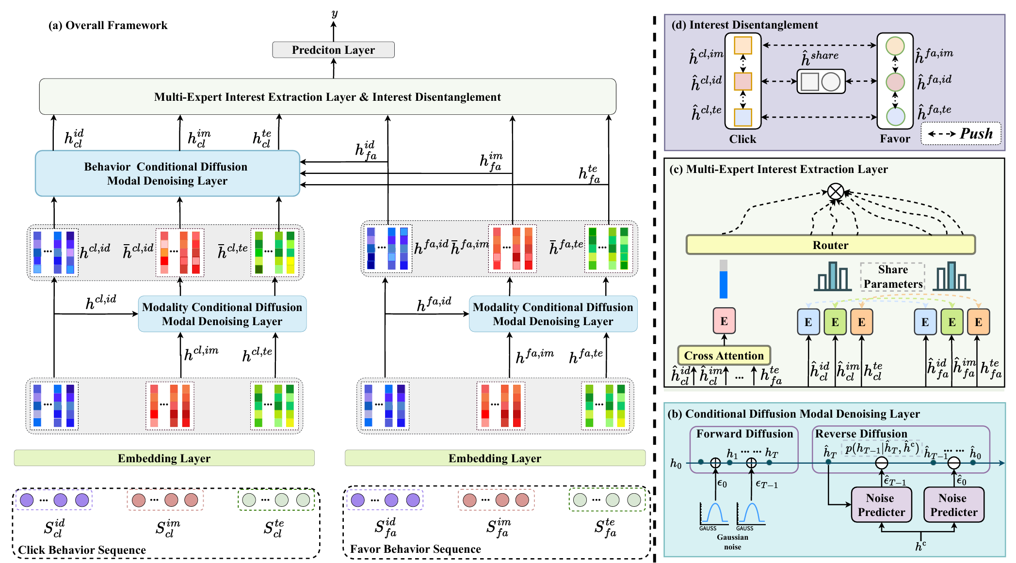
Method

Slide 4
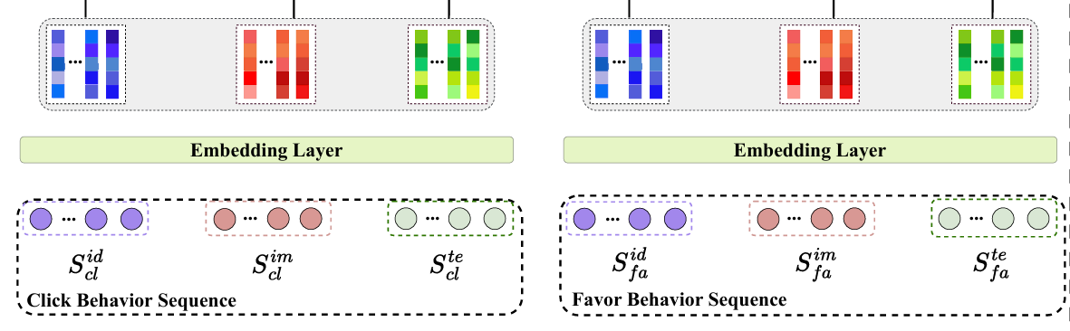



Method

Slide 5
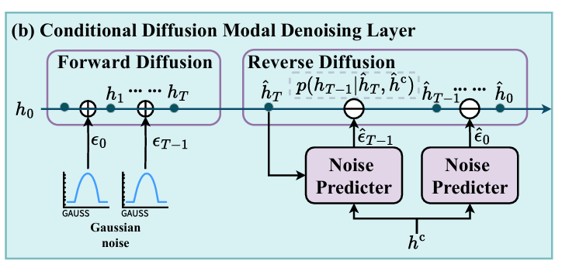

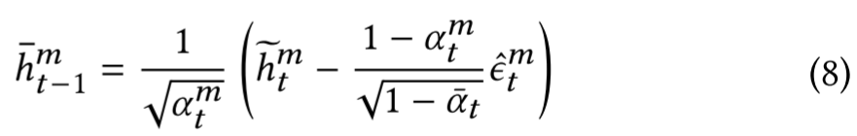
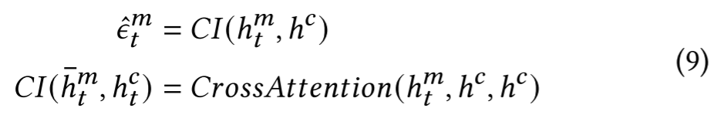
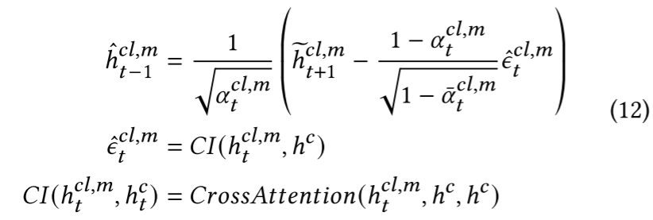
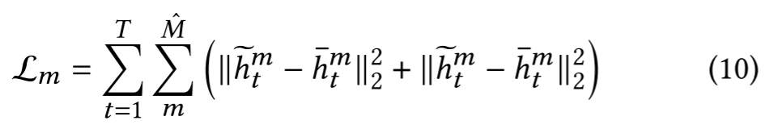
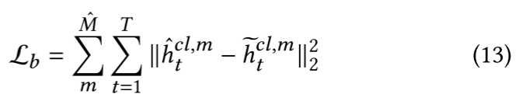

Method

Slide 6
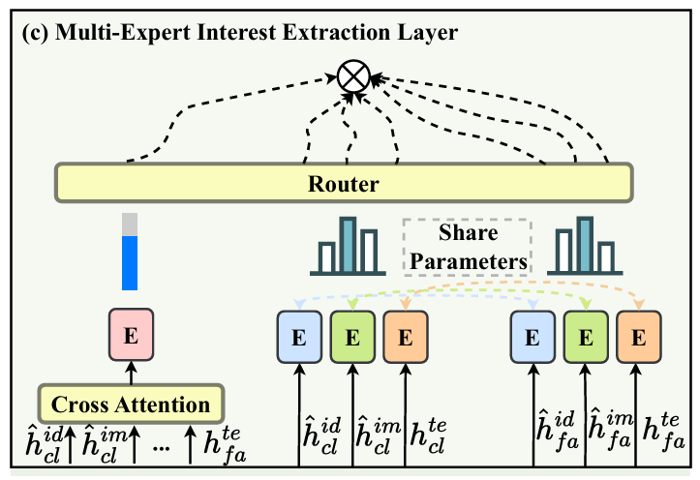
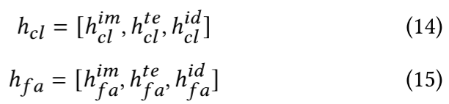

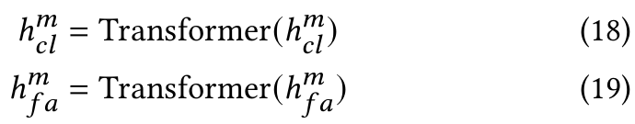
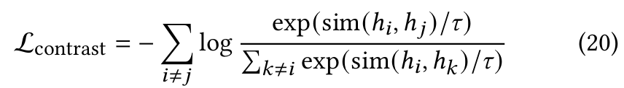
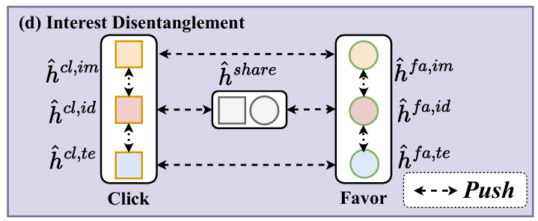
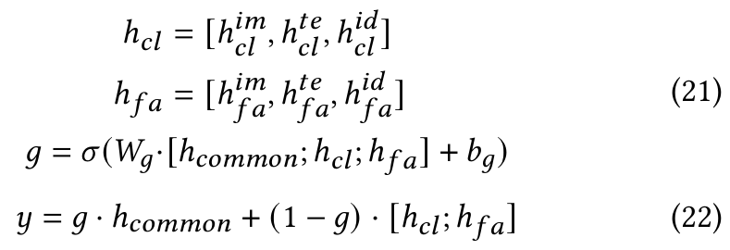
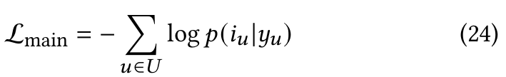
Method

Slide 7
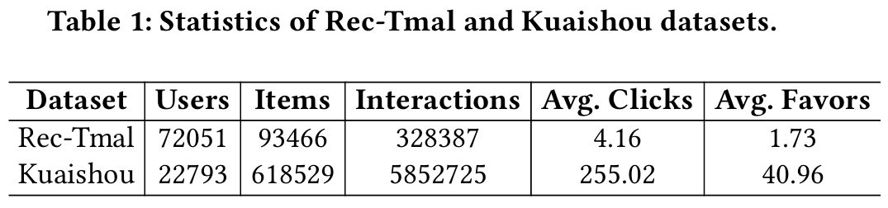
Experiments

Slide 8
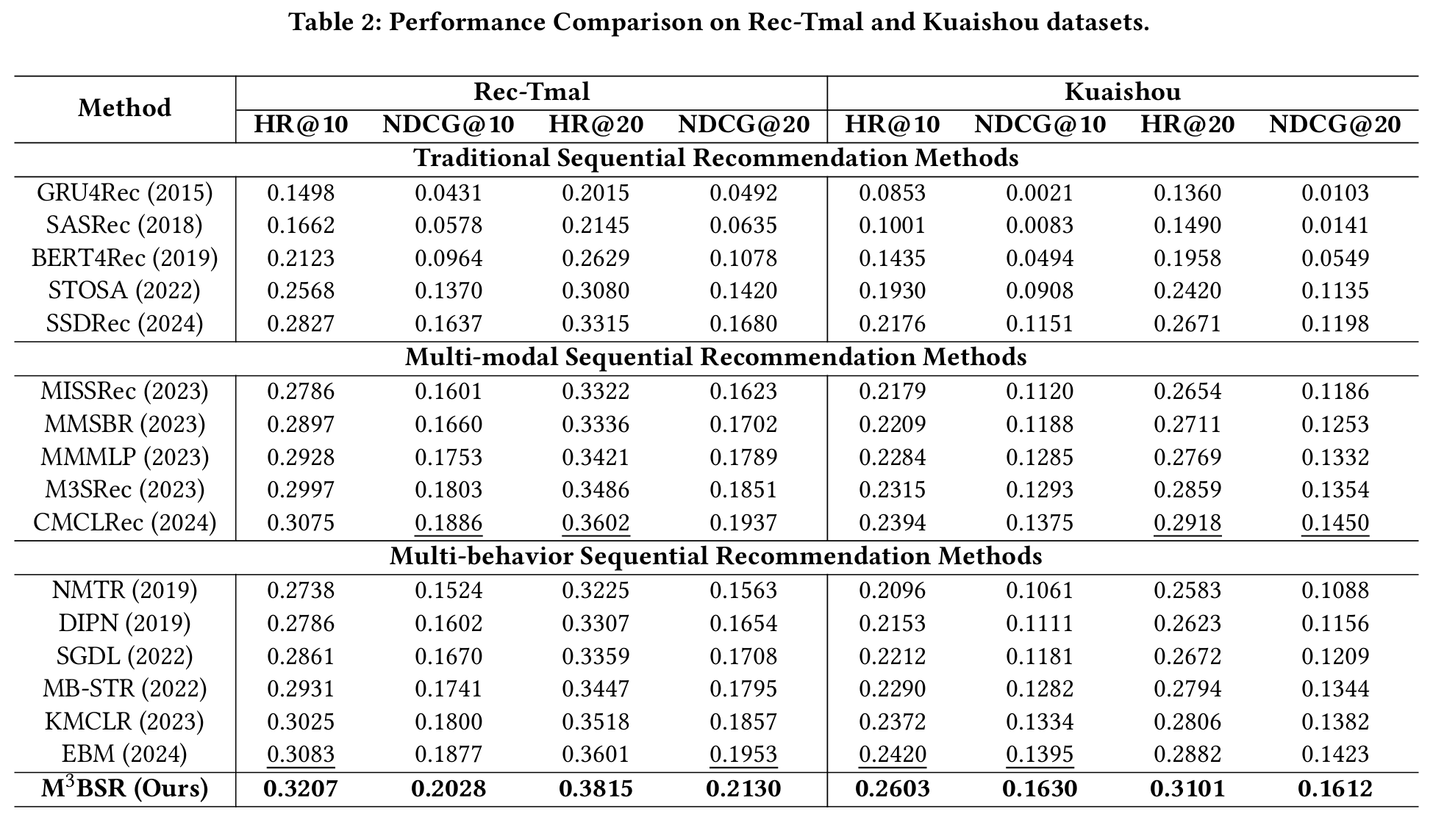
Experiments

Slide 9
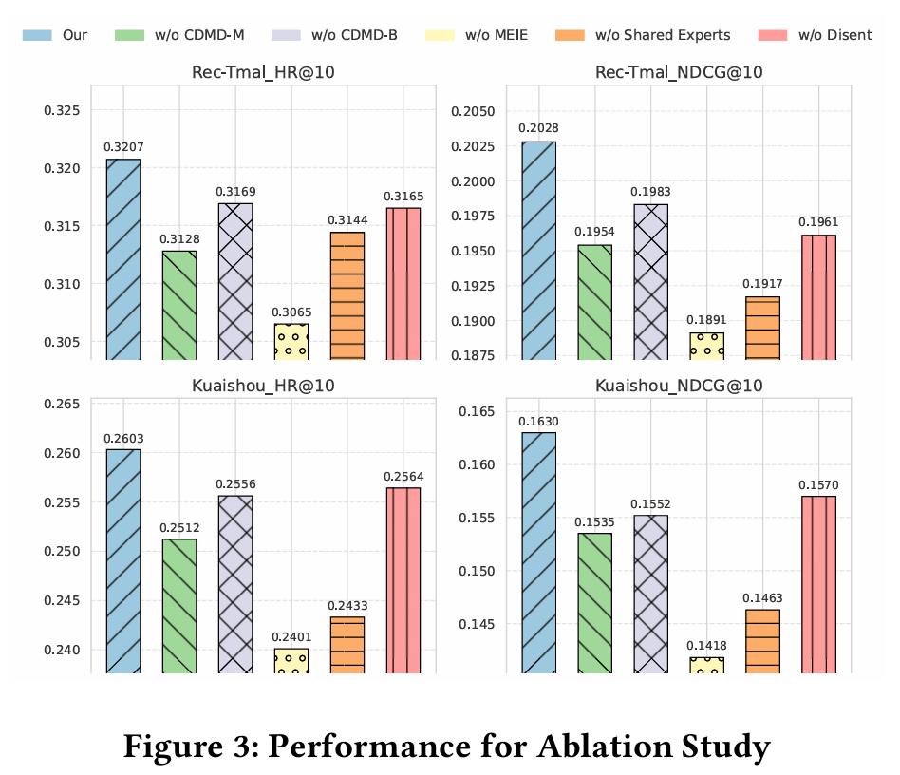
Experiments

Slide 10
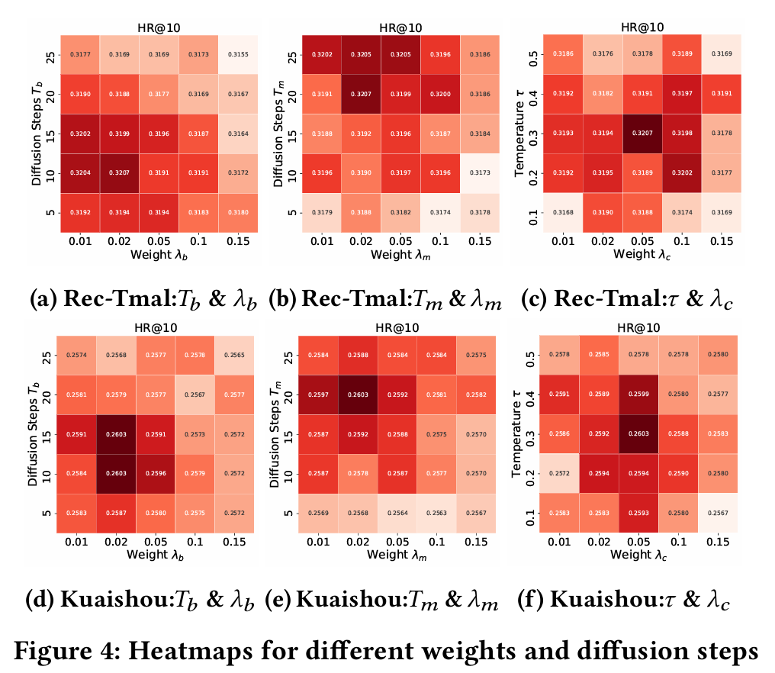
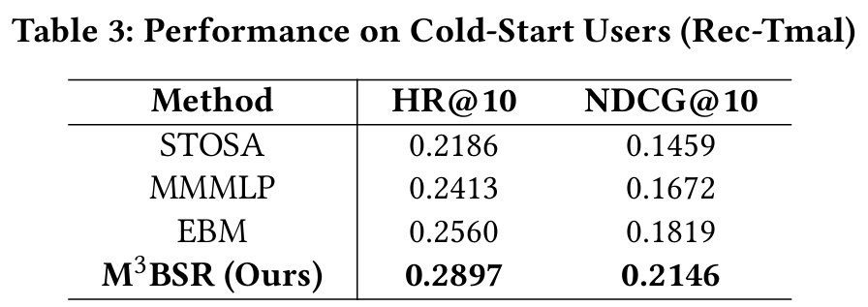
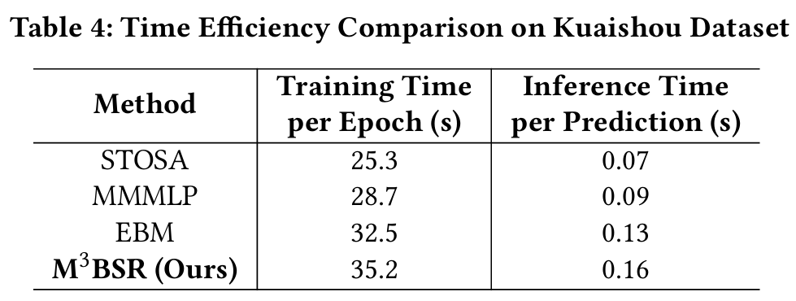
Experiments

Slide 11
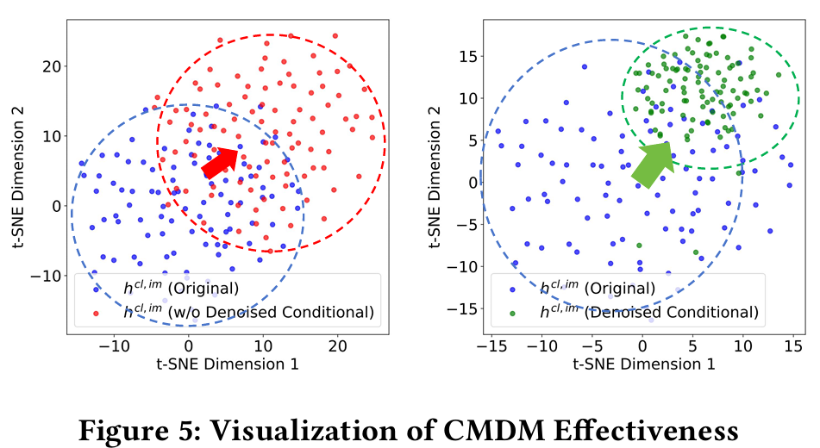
Experiments

Slide 12
Thanks!

